Slide 1
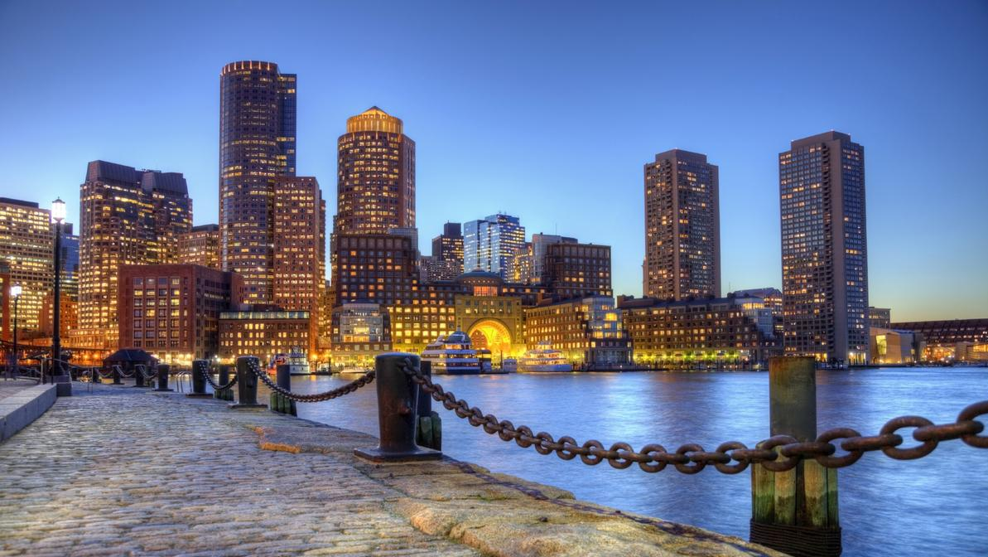
Bring Your Own Water
Day I - Understanding the Marine Microbiome
Notes:
Icebreaker - name + favorite marine organism
What counts as an organism?
Opening Discussion - What is a marine microbiome?

Slide 2
What is ecology?
Where is ecology?
What is your relationship, your connection, with ecology?
Notes:
Write on the board.
Where
can reinforce notion of “biome”
can be in unexpected places too like kitchen sink

Slide 3
Is a scale implied?
Who are the actors in an ecosystem?
Notes:
Scale - doesn’t have to be big
Actors - ecology encompasses both living and nonliving

Slide 4
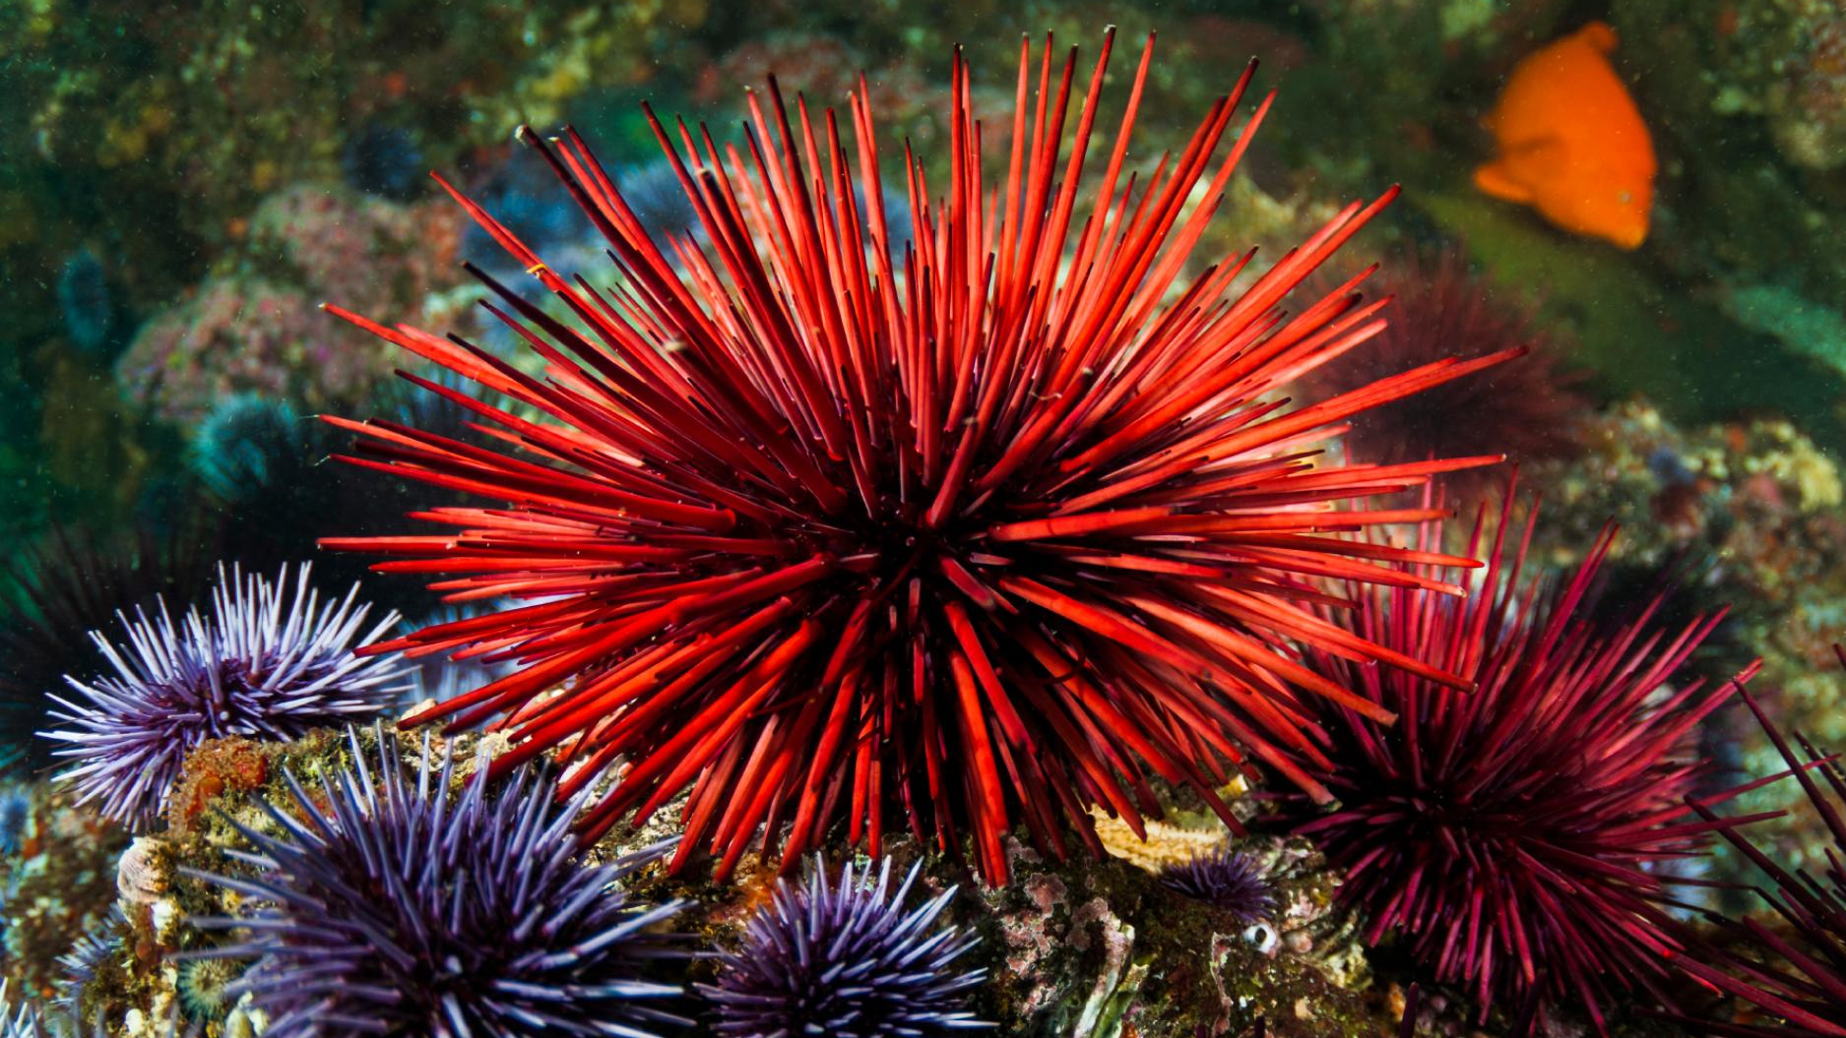
Ecology
concerns i. interacting and ii. the transfer or transformation of energy

Slide 5
How is ecology represented?

Slide 6
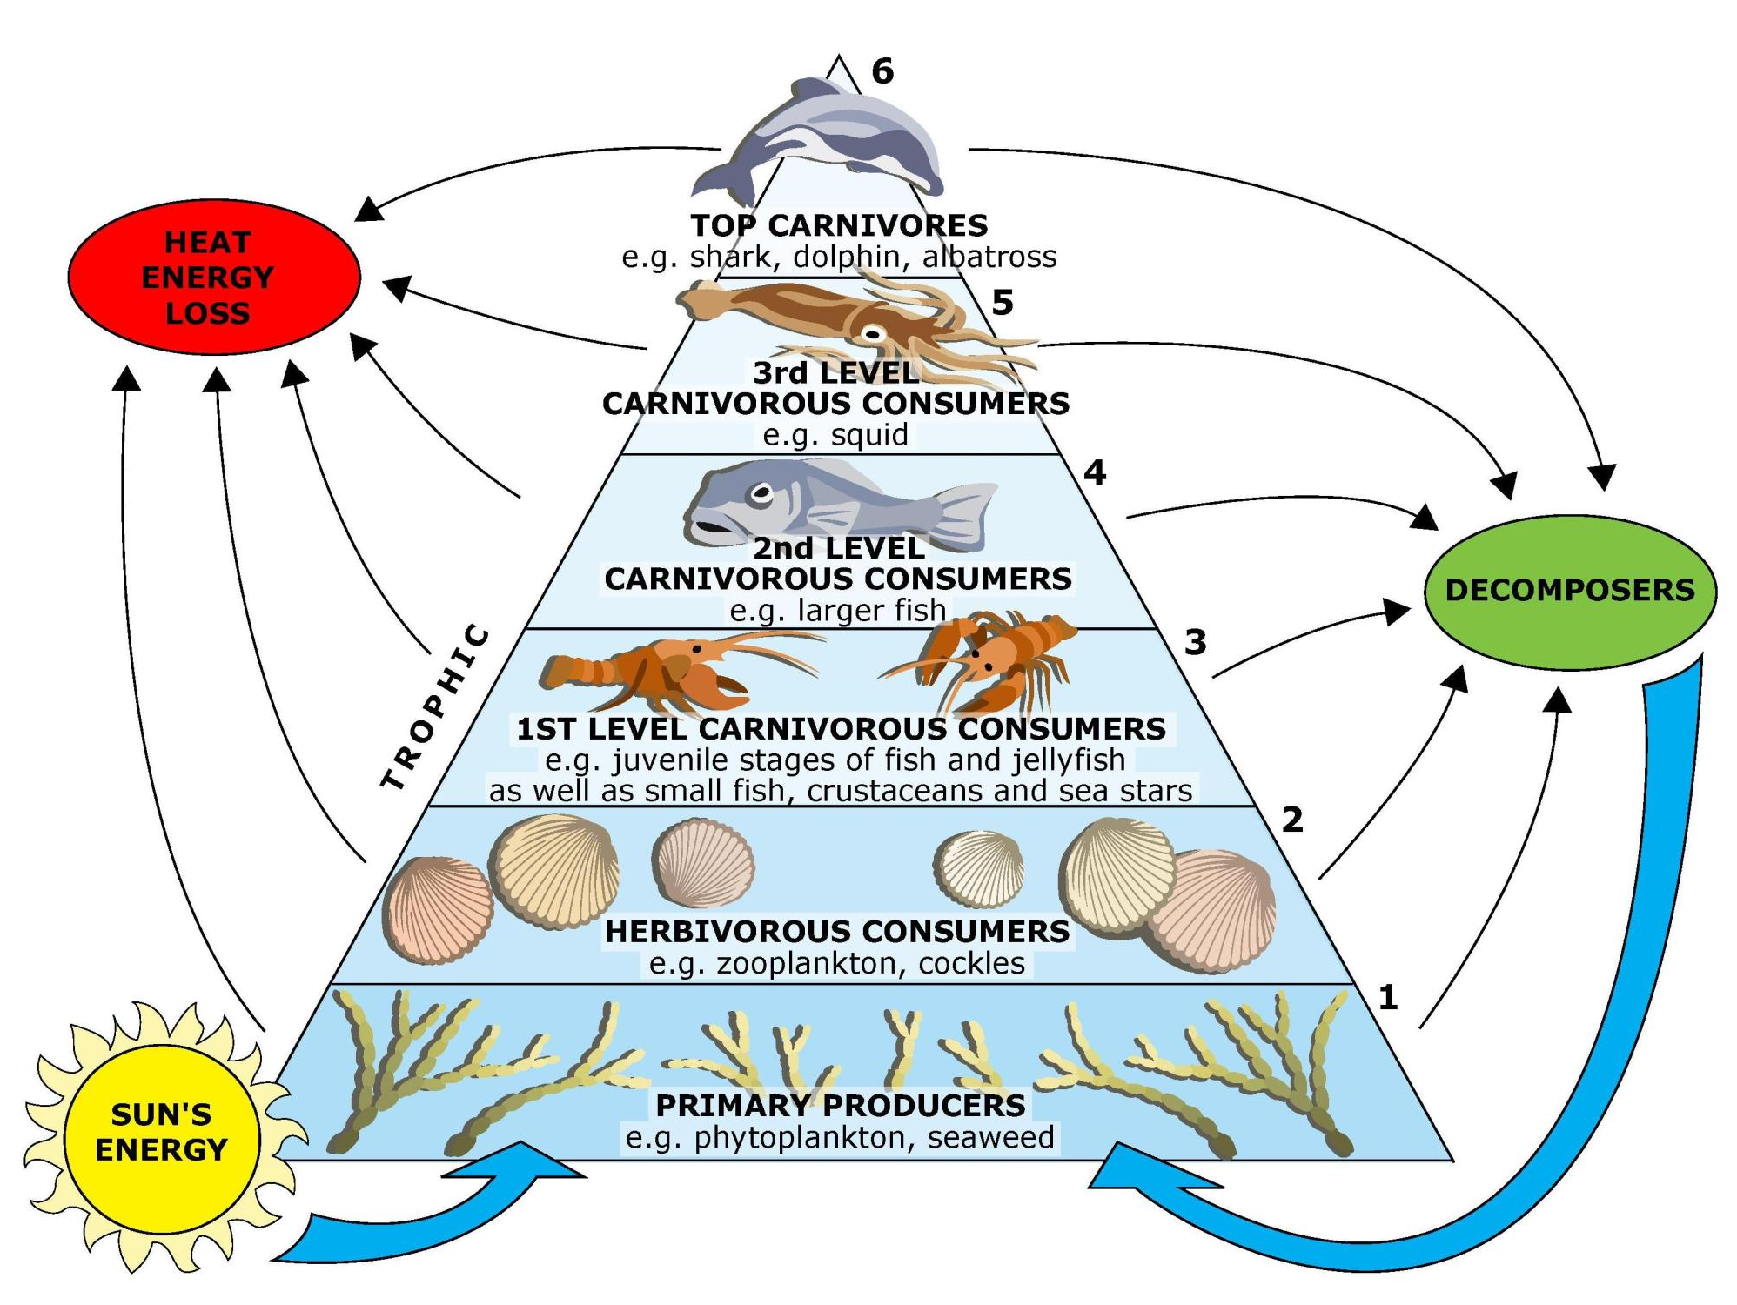
https://www.sciencelearn.org.nz/resources/143-marine-food-webs

Slide 7
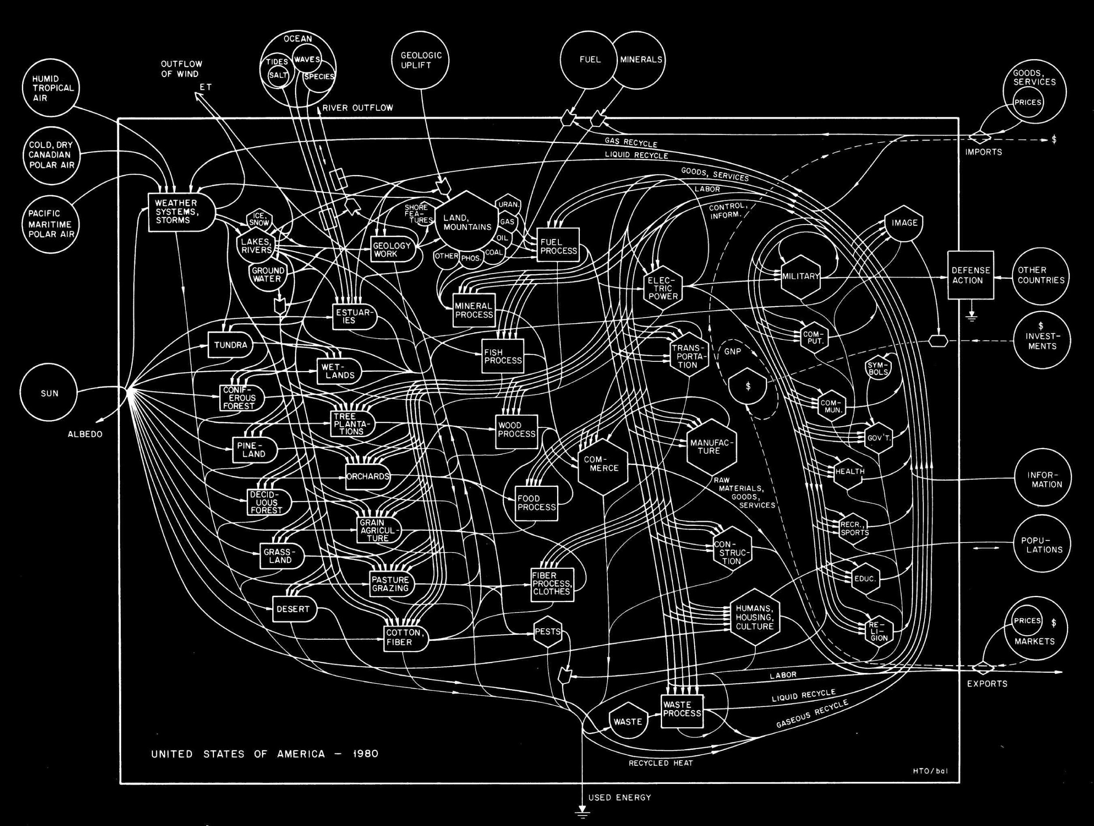

Slide 8
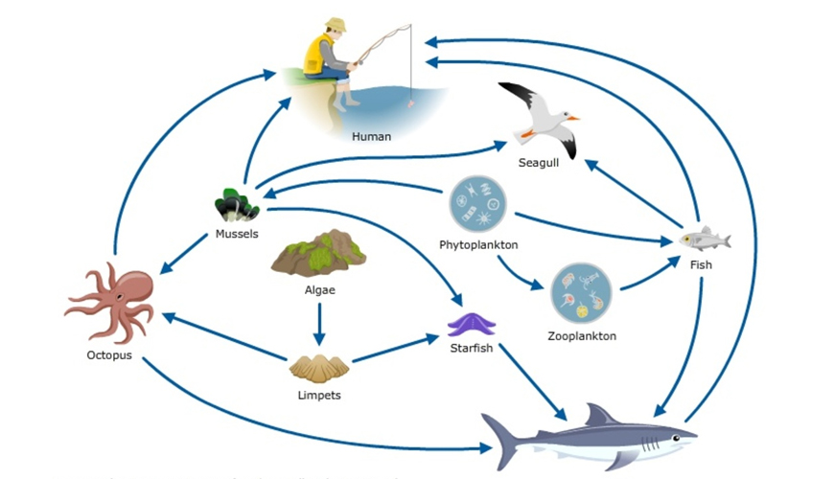
http://www.justscience.in/articles/marine-food-web-interactions/2018/03/06

Slide 9
What types of interactions occur in each example?
At what points is energy, currency being transferred, and how? What, exactly, is the energy being transferred?
How do the representations of ecology differ?
What is the role of humans, their processes, in each, if any?
Notes:
Point out things like the sun, exports, information in the second diagram.
The second diagram and is more complex and therefore more like the ocean - things interact at different levels

Slide 10
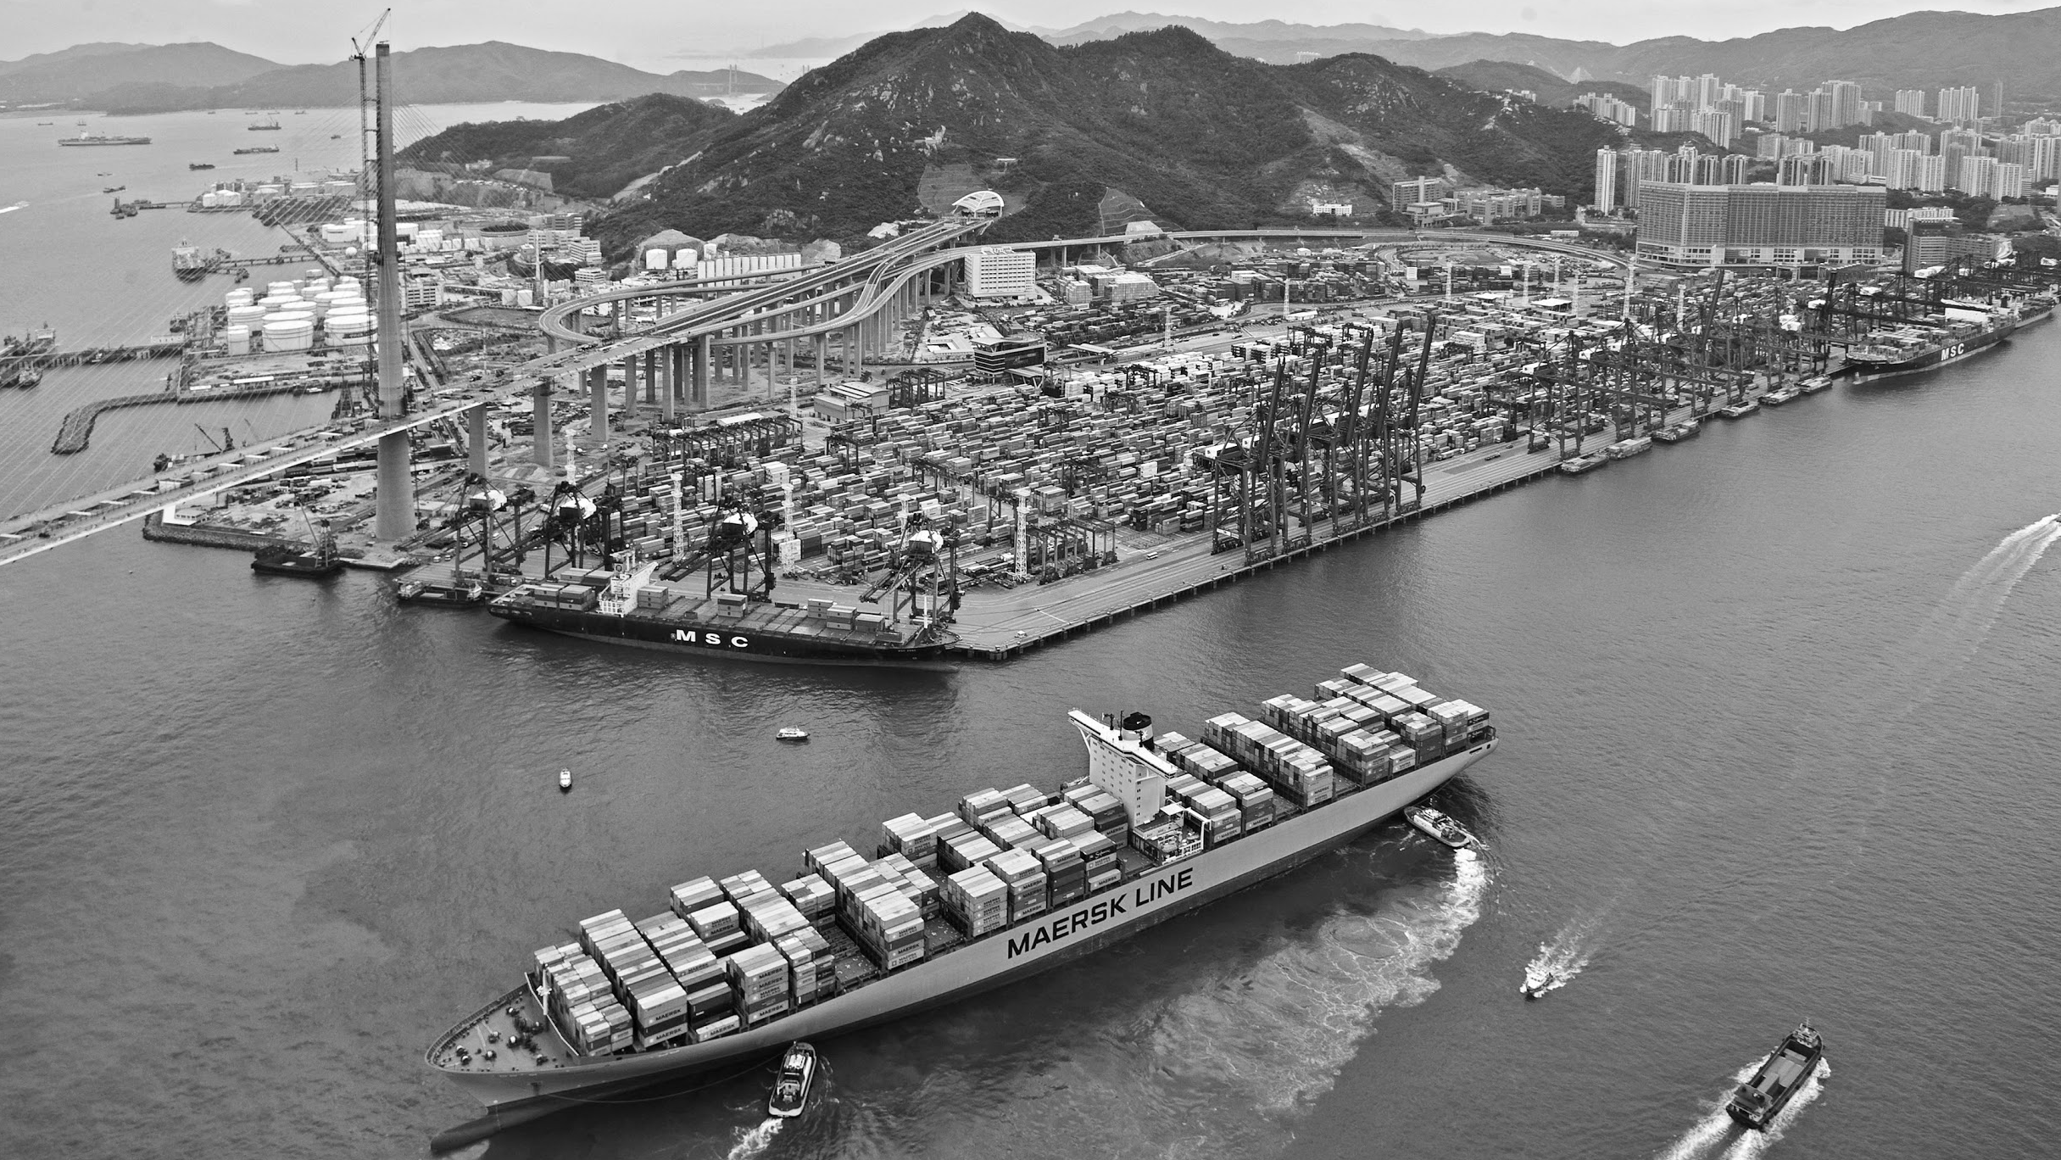
Notes:
What are different interactions?
Biofilming (microorganisms attaching together to create a large, visible film)
Rain (water cycle, e.g. mountain water that carries different organisms/compounds in it)
Industrial Work

Slide 11
Activity:
Draw the Hong Kong Marine Ecosystem

Slide 12
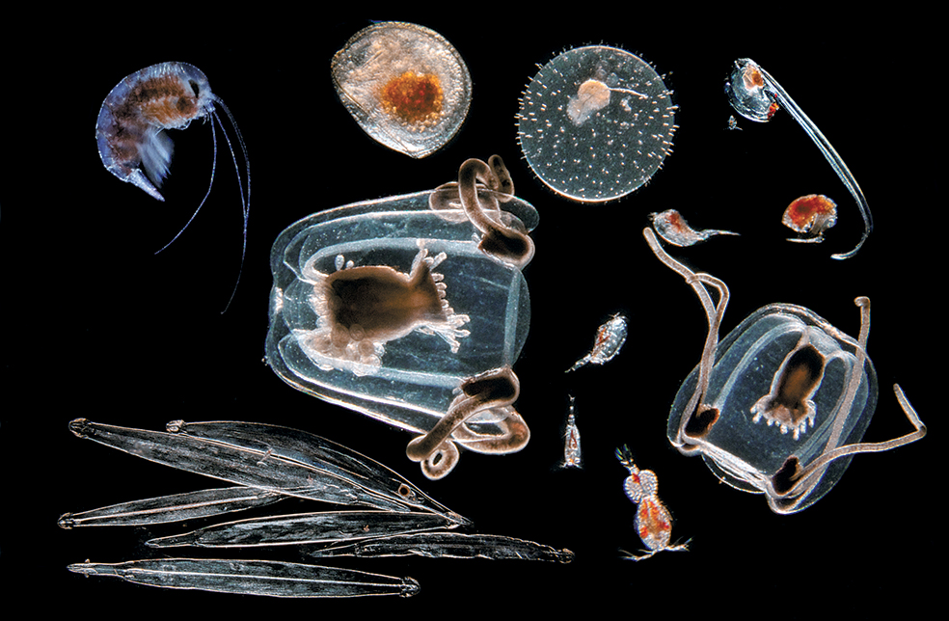
We are at the mercy of microbes.
Notes:
Microbes do photosynthesis and nutrient cycling that are essential for the rest of the ocean.

Slide 13
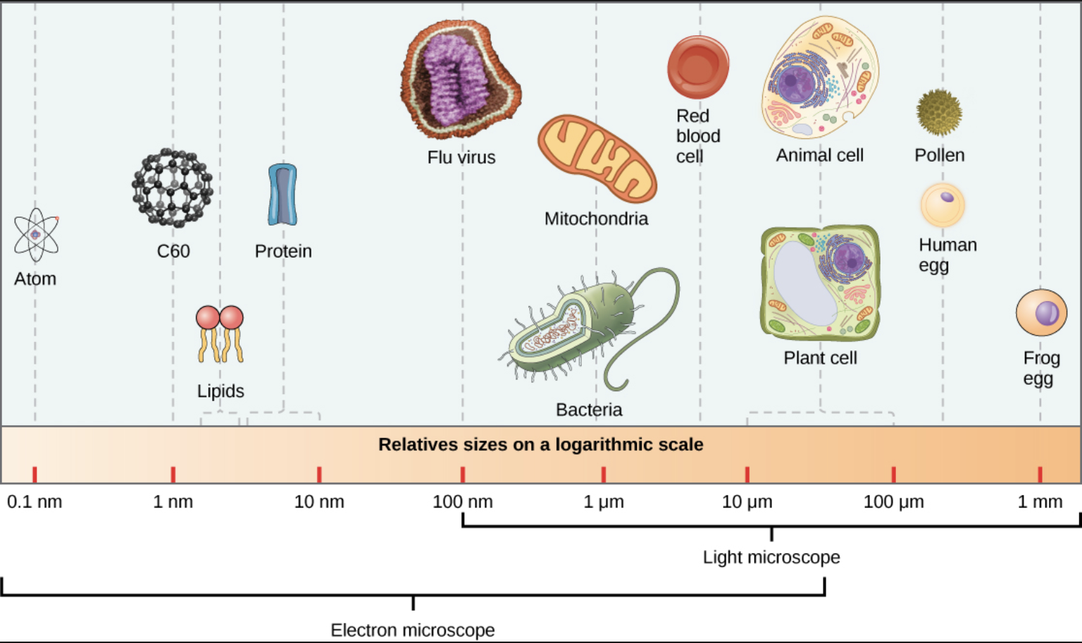
Sizes and Scales
Notes:
Microbes do photosynthesis and nutrient cycling that are essential for the rest of the ocean.

Slide 14
Activity:
Ordering organisms in the ecosystem

Slide 15
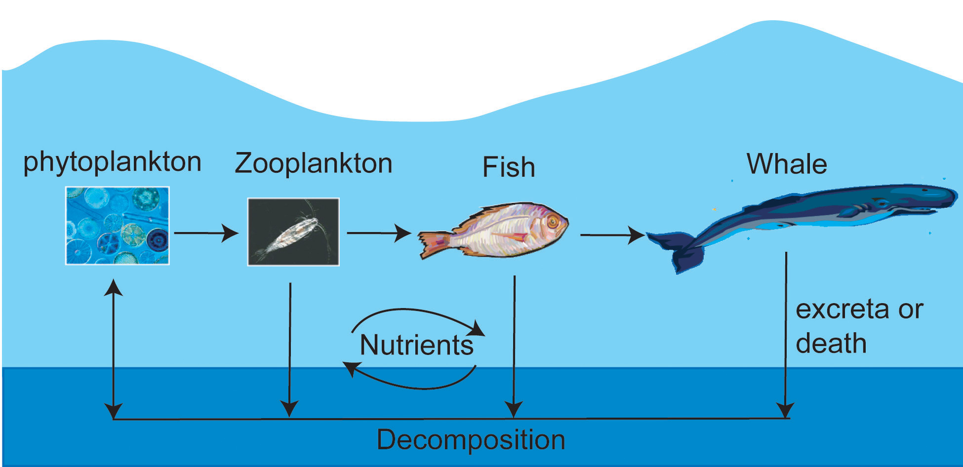

Slide 16
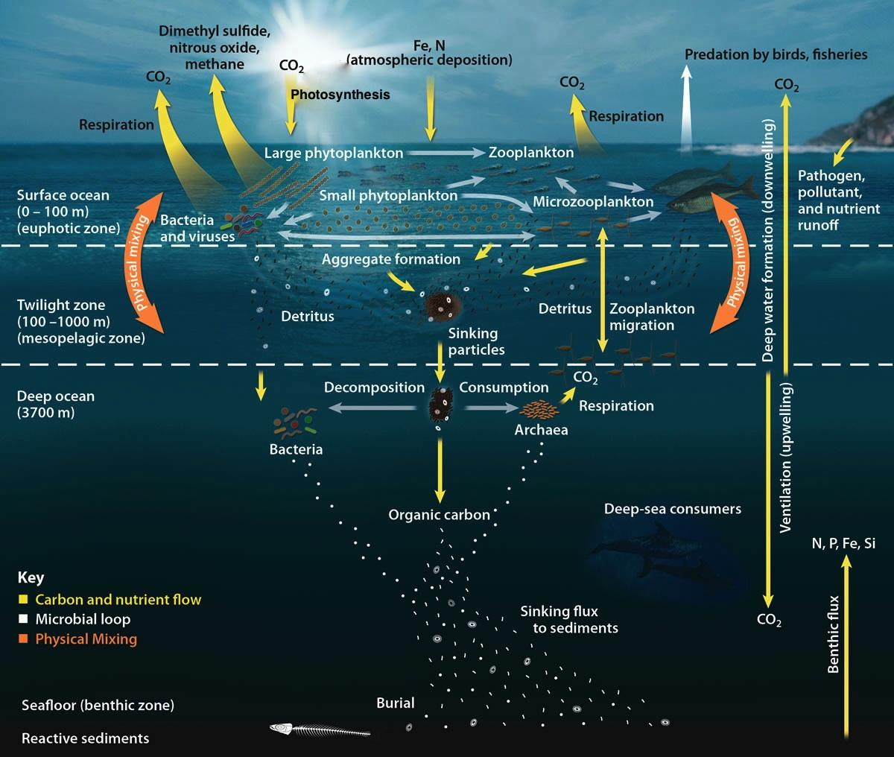
Notes:
Carbon Cycle
Some species (like humans!) produce CO2 through respiration, while other species (like plants) need it to make food through photosynthesis.
Importance: The carbon cycle is important because CO2 in the atmosphere creates a “blanket” that traps in heat.

Slide 17
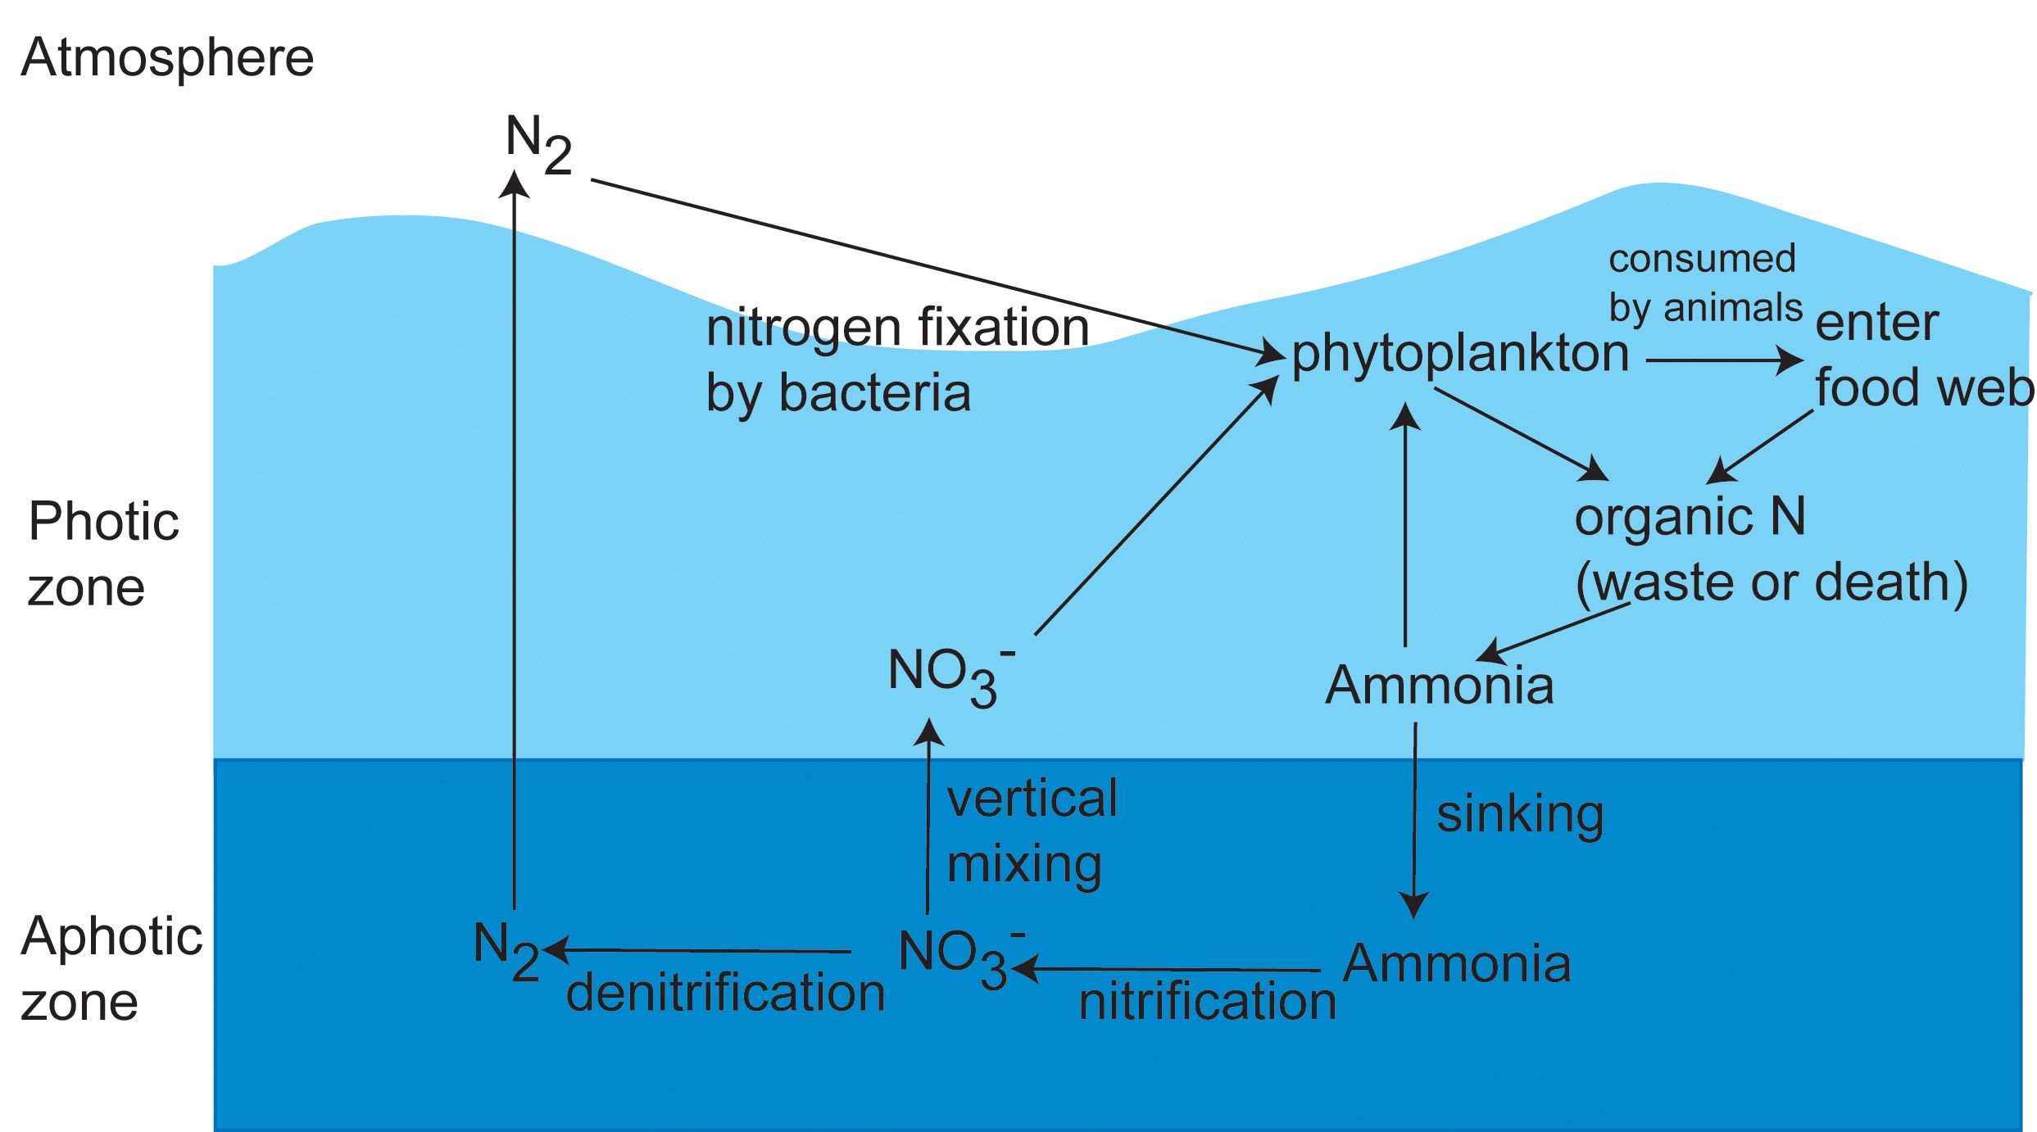
Notes:
Nitrogen Fixation - Nitrogen is important because we use it in DNA, proteins, amino acids, and more. Plants use it to make chlorophyll and therefore food.
Also explain photic zone vs aphotic zone

Slide 18
Activity:
Plate the marine microbiome

